Slide 1

12/20 Report
By Bolun

Slide 2
Start
One iteration with putting back points（fixed）
Method 2
( Method 1 is Using LP only)
Input Data
Solve LP
Delete Outliers from data
Outliers exist?
Yes
# of Outliers changed?
No
No
Yes
Start a new loop
Yes
Loop a whole sequence?
No
Put a point back to data in order
Output Data
Is it an outlier?
Yes
Delete the point from data
End
No

Slide 3
Start
One iteration with Ri（fixed）
Method 3
Input Data
Solve LP
Delete Outliers from data
Outliers exist?
Yes
No
Compute Ri of outliers
Yes
Is max Ri <=1
Delete the point from data
Output Data
No
Yes
Put point with max Ri back to data
Is it an outlier?
End
No

Slide 4
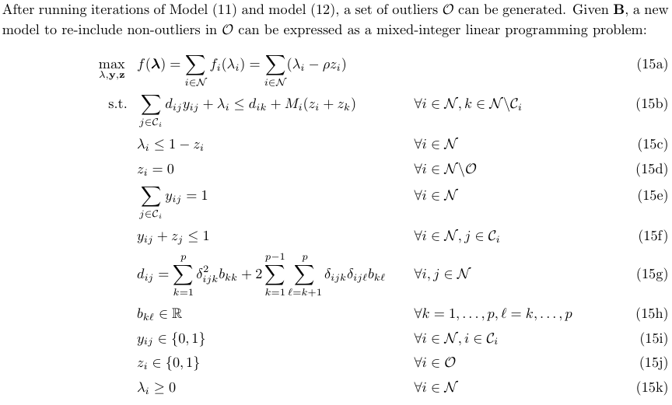
6.3 MILP
To re-add non-outliers into the dataset
<=Yij≠1 if Zj=1
<=Parameter

Slide 5
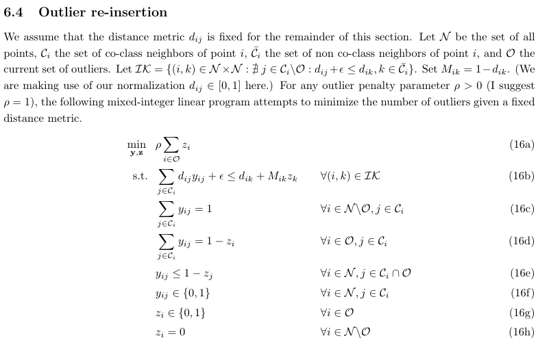
Improvement

Slide 6
Start
Whole Process of MILP
Method4
Input Data
Solve LP
Delete Outliers from data
Outliers exist?
Yes
No
Solve MILP
Output Data
End

Slide 7
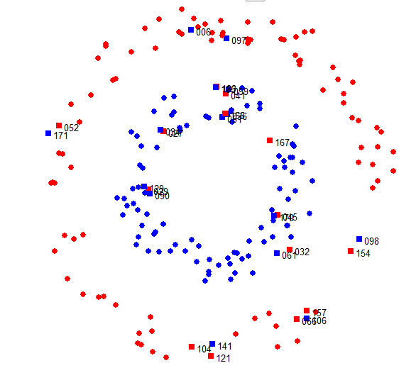
Original Data

Slide 8
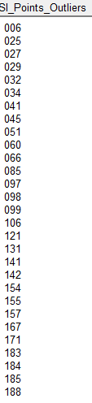
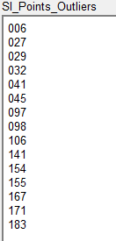
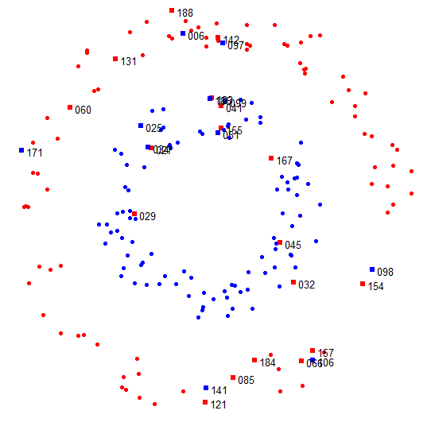
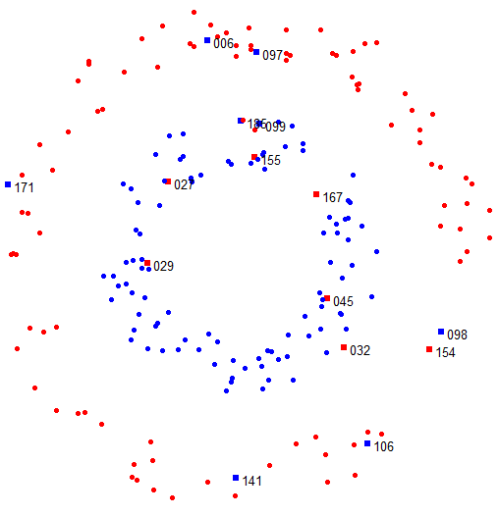

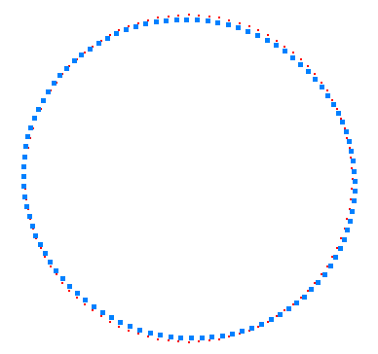
LP Solution
MIP Solution
Distance Metrix

Slide 9
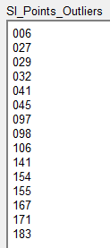
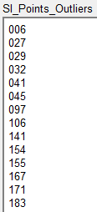
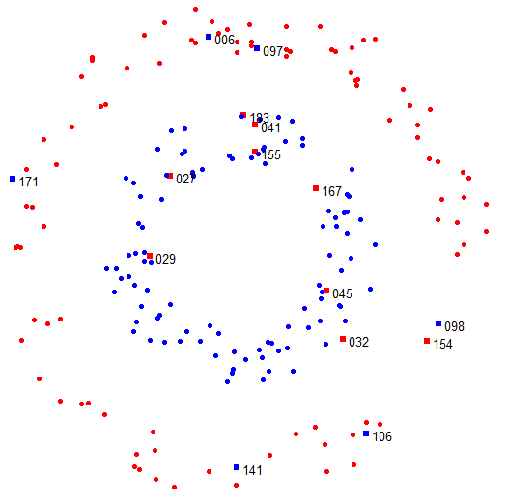
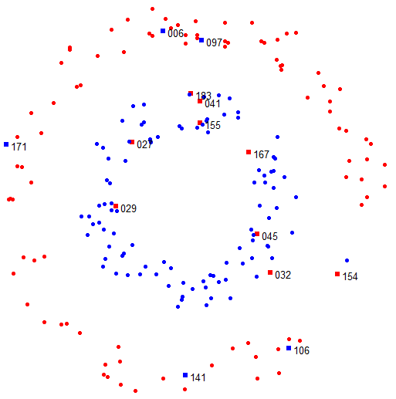


Method 2
1 iteration
Method3
1 iteration
Distance Matrix
Distance Matrix

Slide 10


Example
Original Data
After inserting new data

Slide 11
Thank you !

